Slide 1
Doodler
An application for Doodle lovers

Slide 2

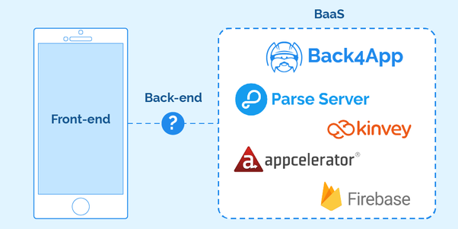
Architecture
Used Parse Dashboard which is an open source BaaS from Facebook
Servers are created by parse dashboard and using Back4App deployed to Heroku
Application built on Android using a few packages
Different activities with fragments and bottom navigation menu

Slide 3
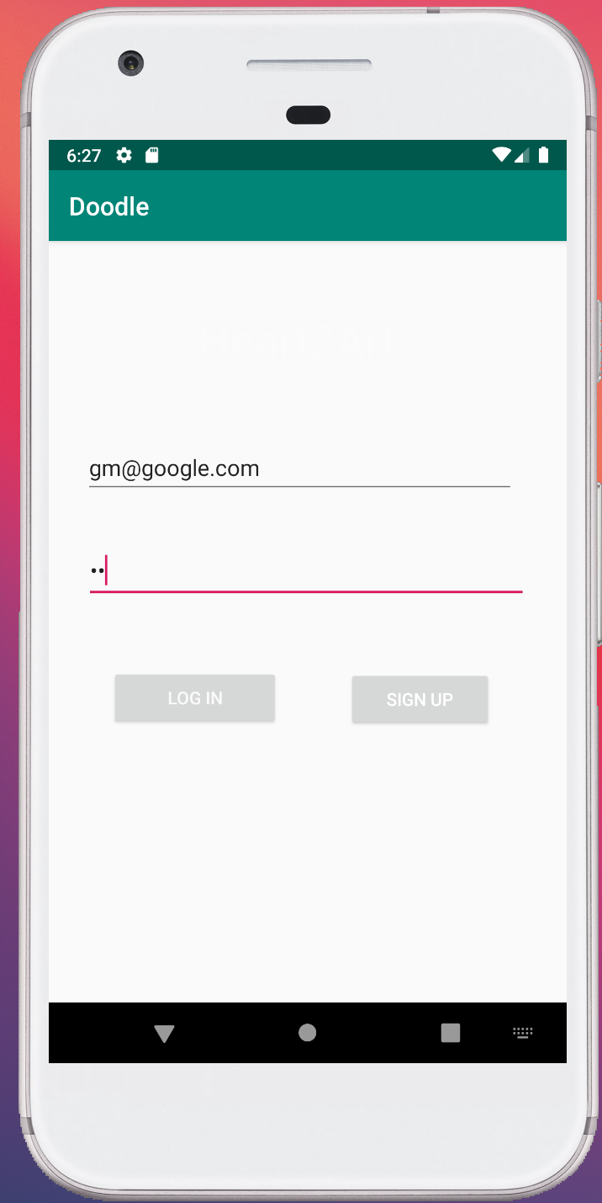
Login
● User can login to use application
● Username and Password is required
● Wrong username/password will show a toast

Slide 4
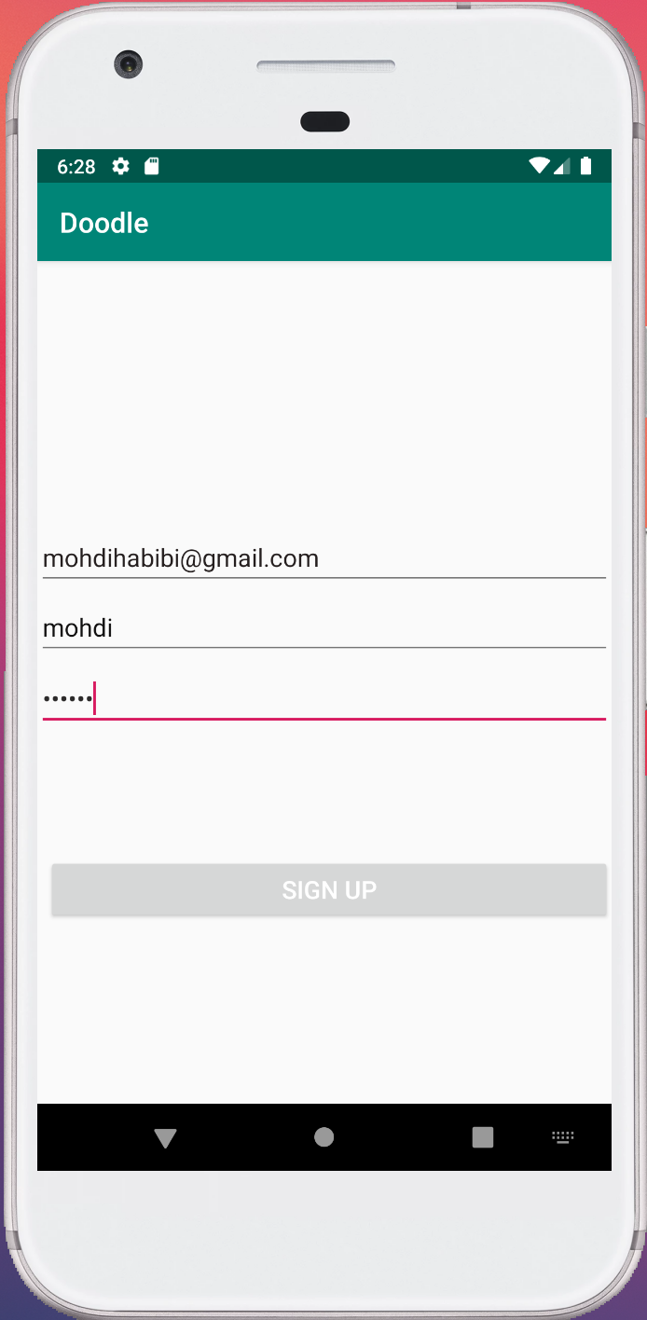
Sign Up
User can Sign up if they don’t have account
Required part Email, Username, Password
Optional information Tile, Brief Bio about the
user, Location
After successfully sign up, User is saved in the
parse dashboard

Slide 5
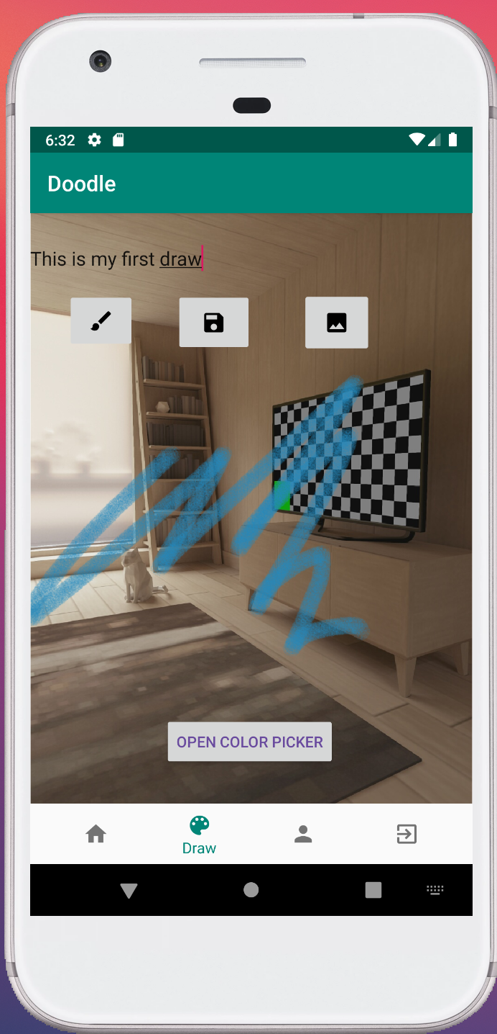
Doodle page
Color Picker offers an infinite amount of colors
User can upload a picture from their device
User has the option to choose between different
size of brush
After drawing on the fragment or on a picture, user
can save their drawing for future reference
Utilized a Intent.ACTION_PICK

Slide 6
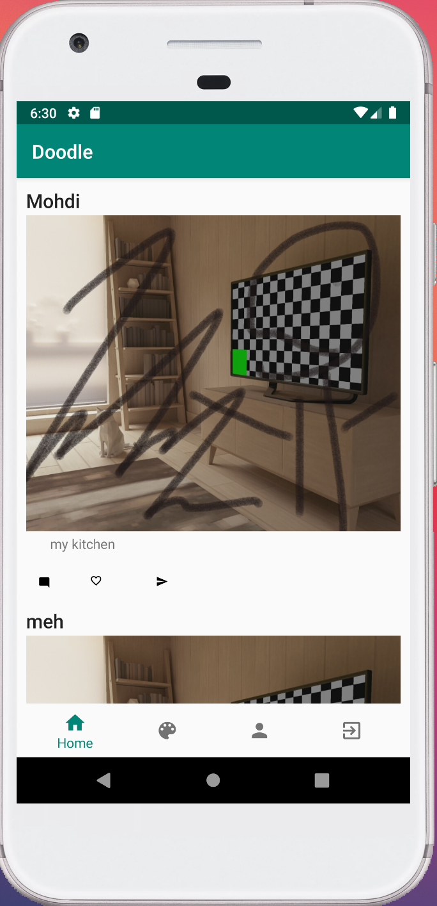
Feed
Posts are shown from every User and him/her friends within the Parse Dashboard
Each User’s username will be shown
Current User’s posts will also be shown
Like, Comment, & Share features are used to imitate common mobile apps

Slide 7
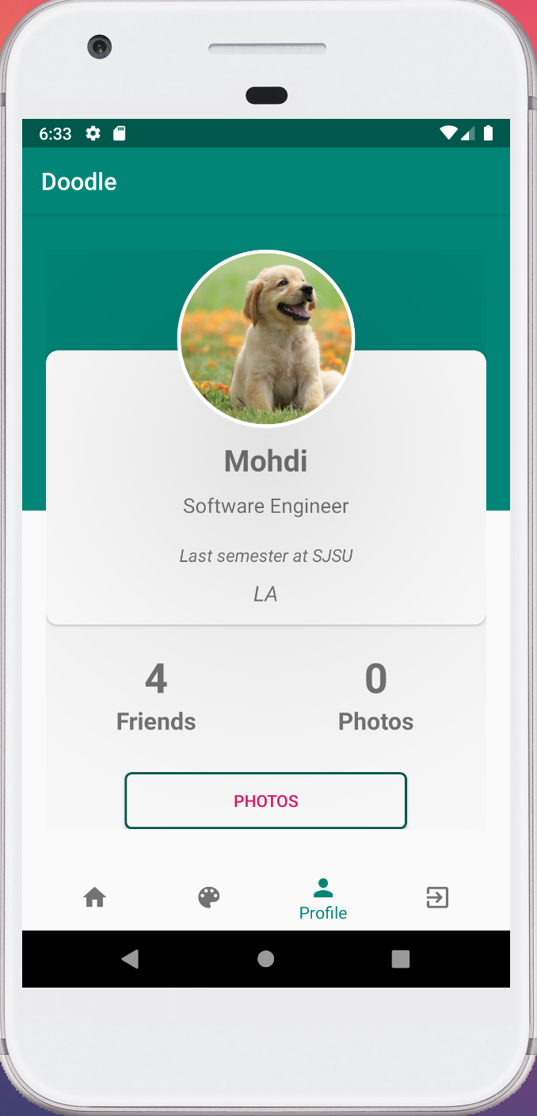
Profile
User can see their own posts only
See description and bio of the user
Give user an overview of their profile
A button that load just their posts

Slide 8
Demo

